Slide 1

Systems Surveillance and Monitoring
Physical Security for 5G Networks
Video 8.3

Slide 2

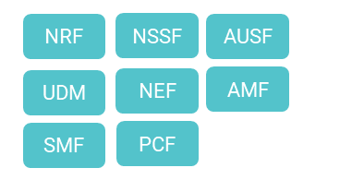


5G Physical Network
User
Equipment
Antenna
Remote Radio Unit
Far Edge
Cloud
Edge Cloud
Core Cloud
Large Cells
Small Cells
Hubs
Outside Plant
Central Office
Small Data Center
Large Data Center

Slide 3
Best Practices
Systems Surveillance and Monitoring
Monitoring Use IoT devices to monitor equipment and facility spaces.
No Default Remove default usernames, passwords, and port assignments.
Inventory Know what is and what should be on network.
Audit Inspect and validate security infrastructure is viable.
Vigilance Utilize industry and security partners to stay alert to new threats.

Slide 4
Key Takeaways
01
Strong Justification
Necessary to protect and act.
02
Best Practices Can Help
Inventory, monitor, audit, remove defaults.
03
Stay Vigilant
Threats never cease.

Slide 5
Network Access Security
Next Video

